Slide 1
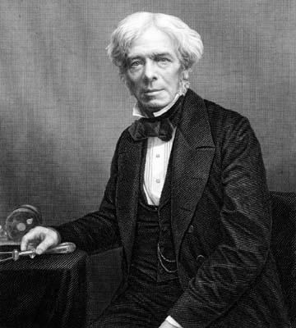
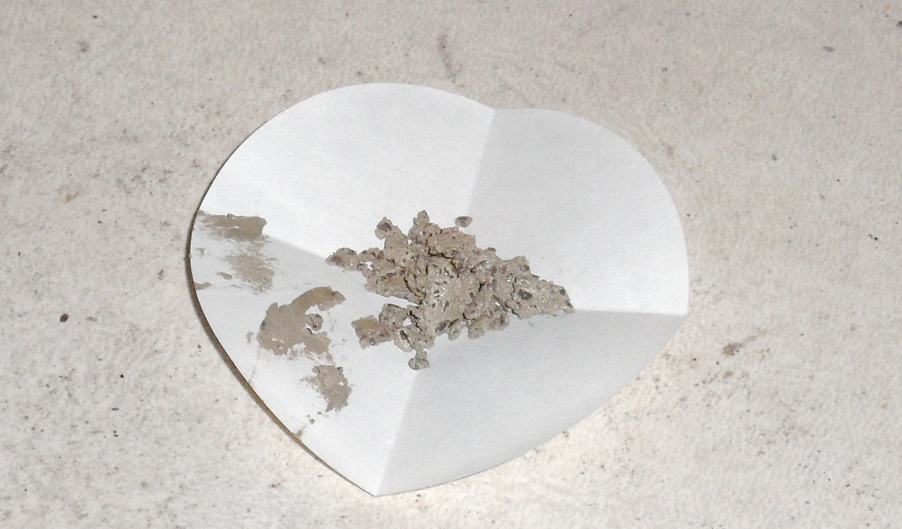
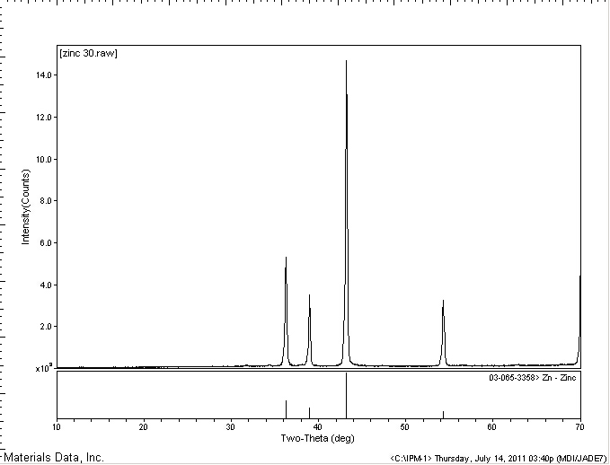
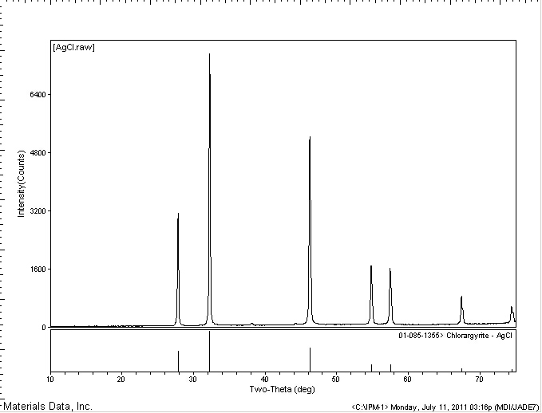
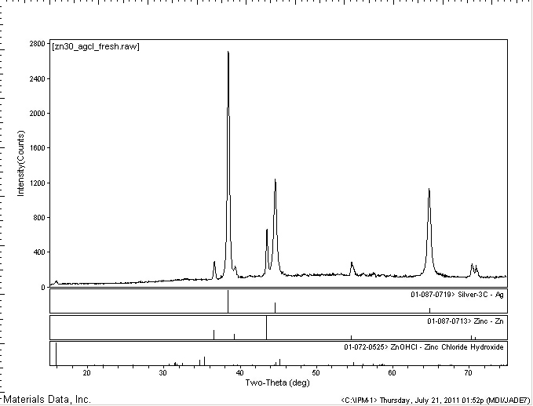
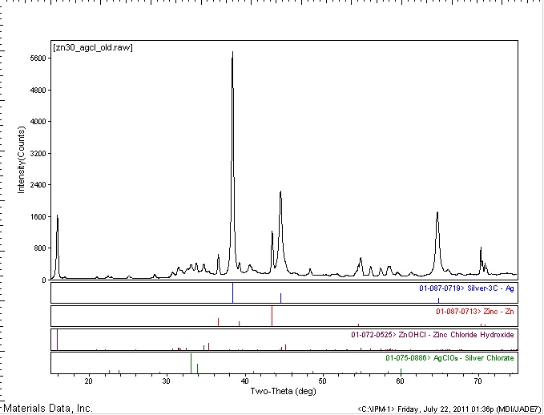
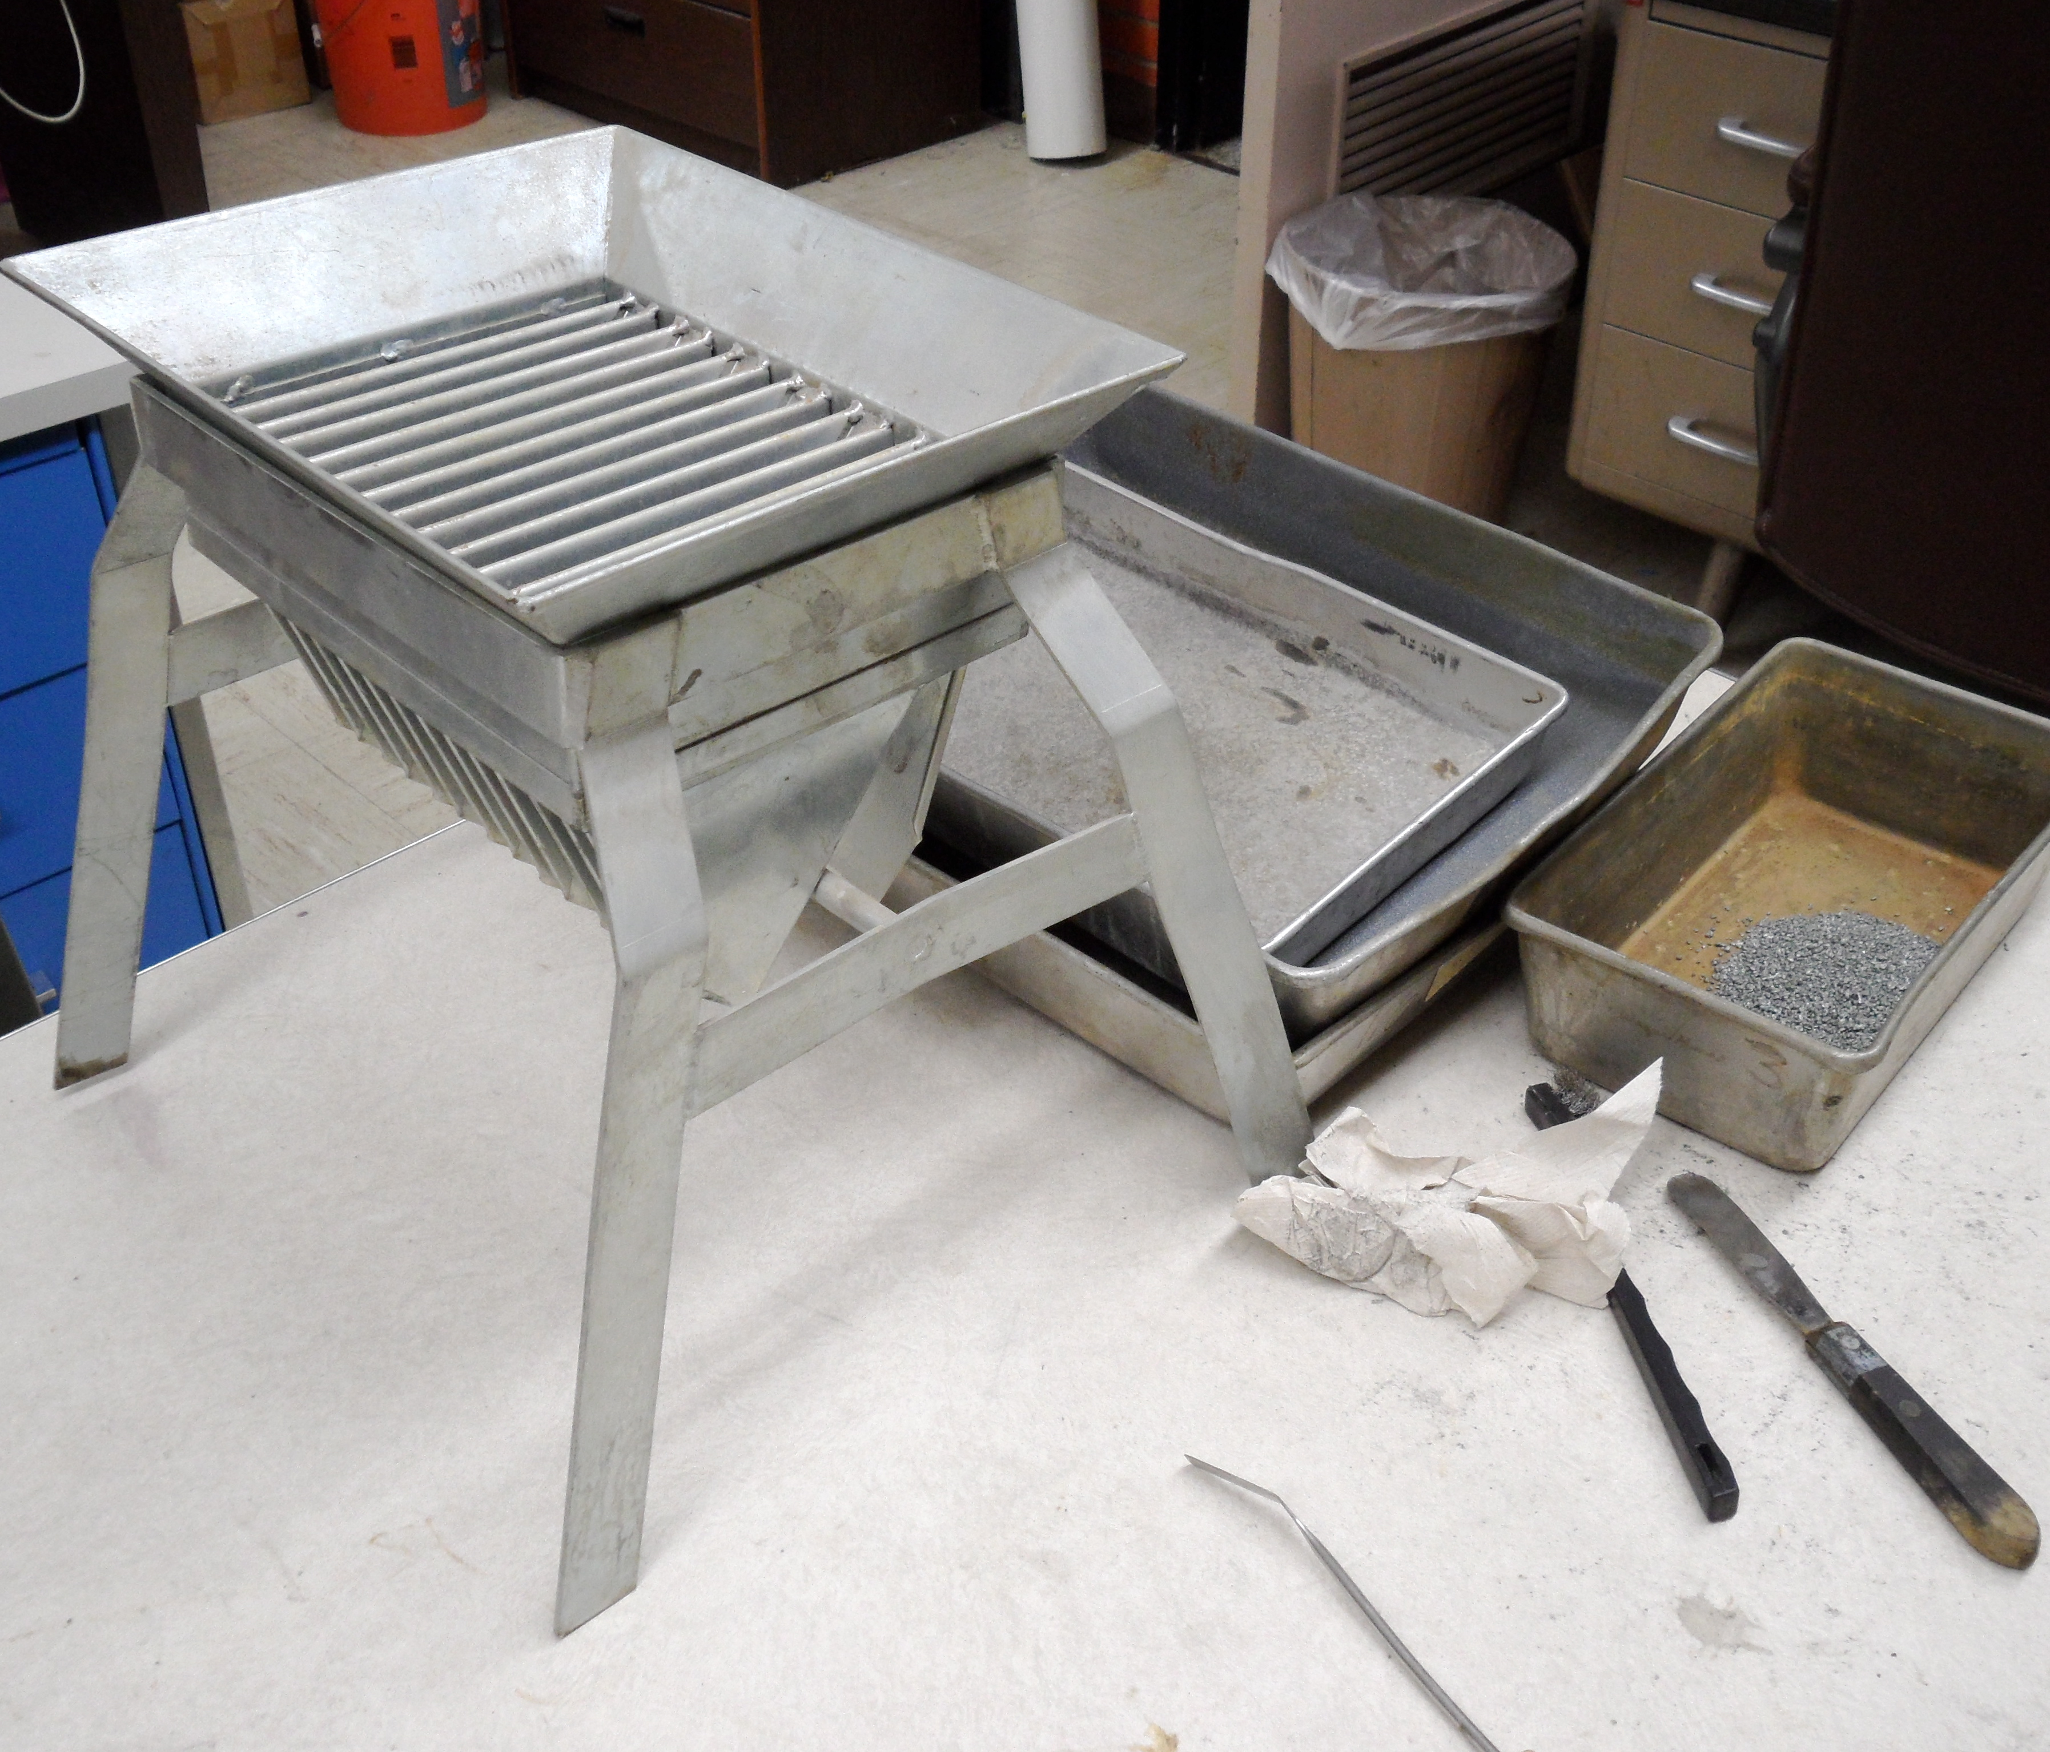
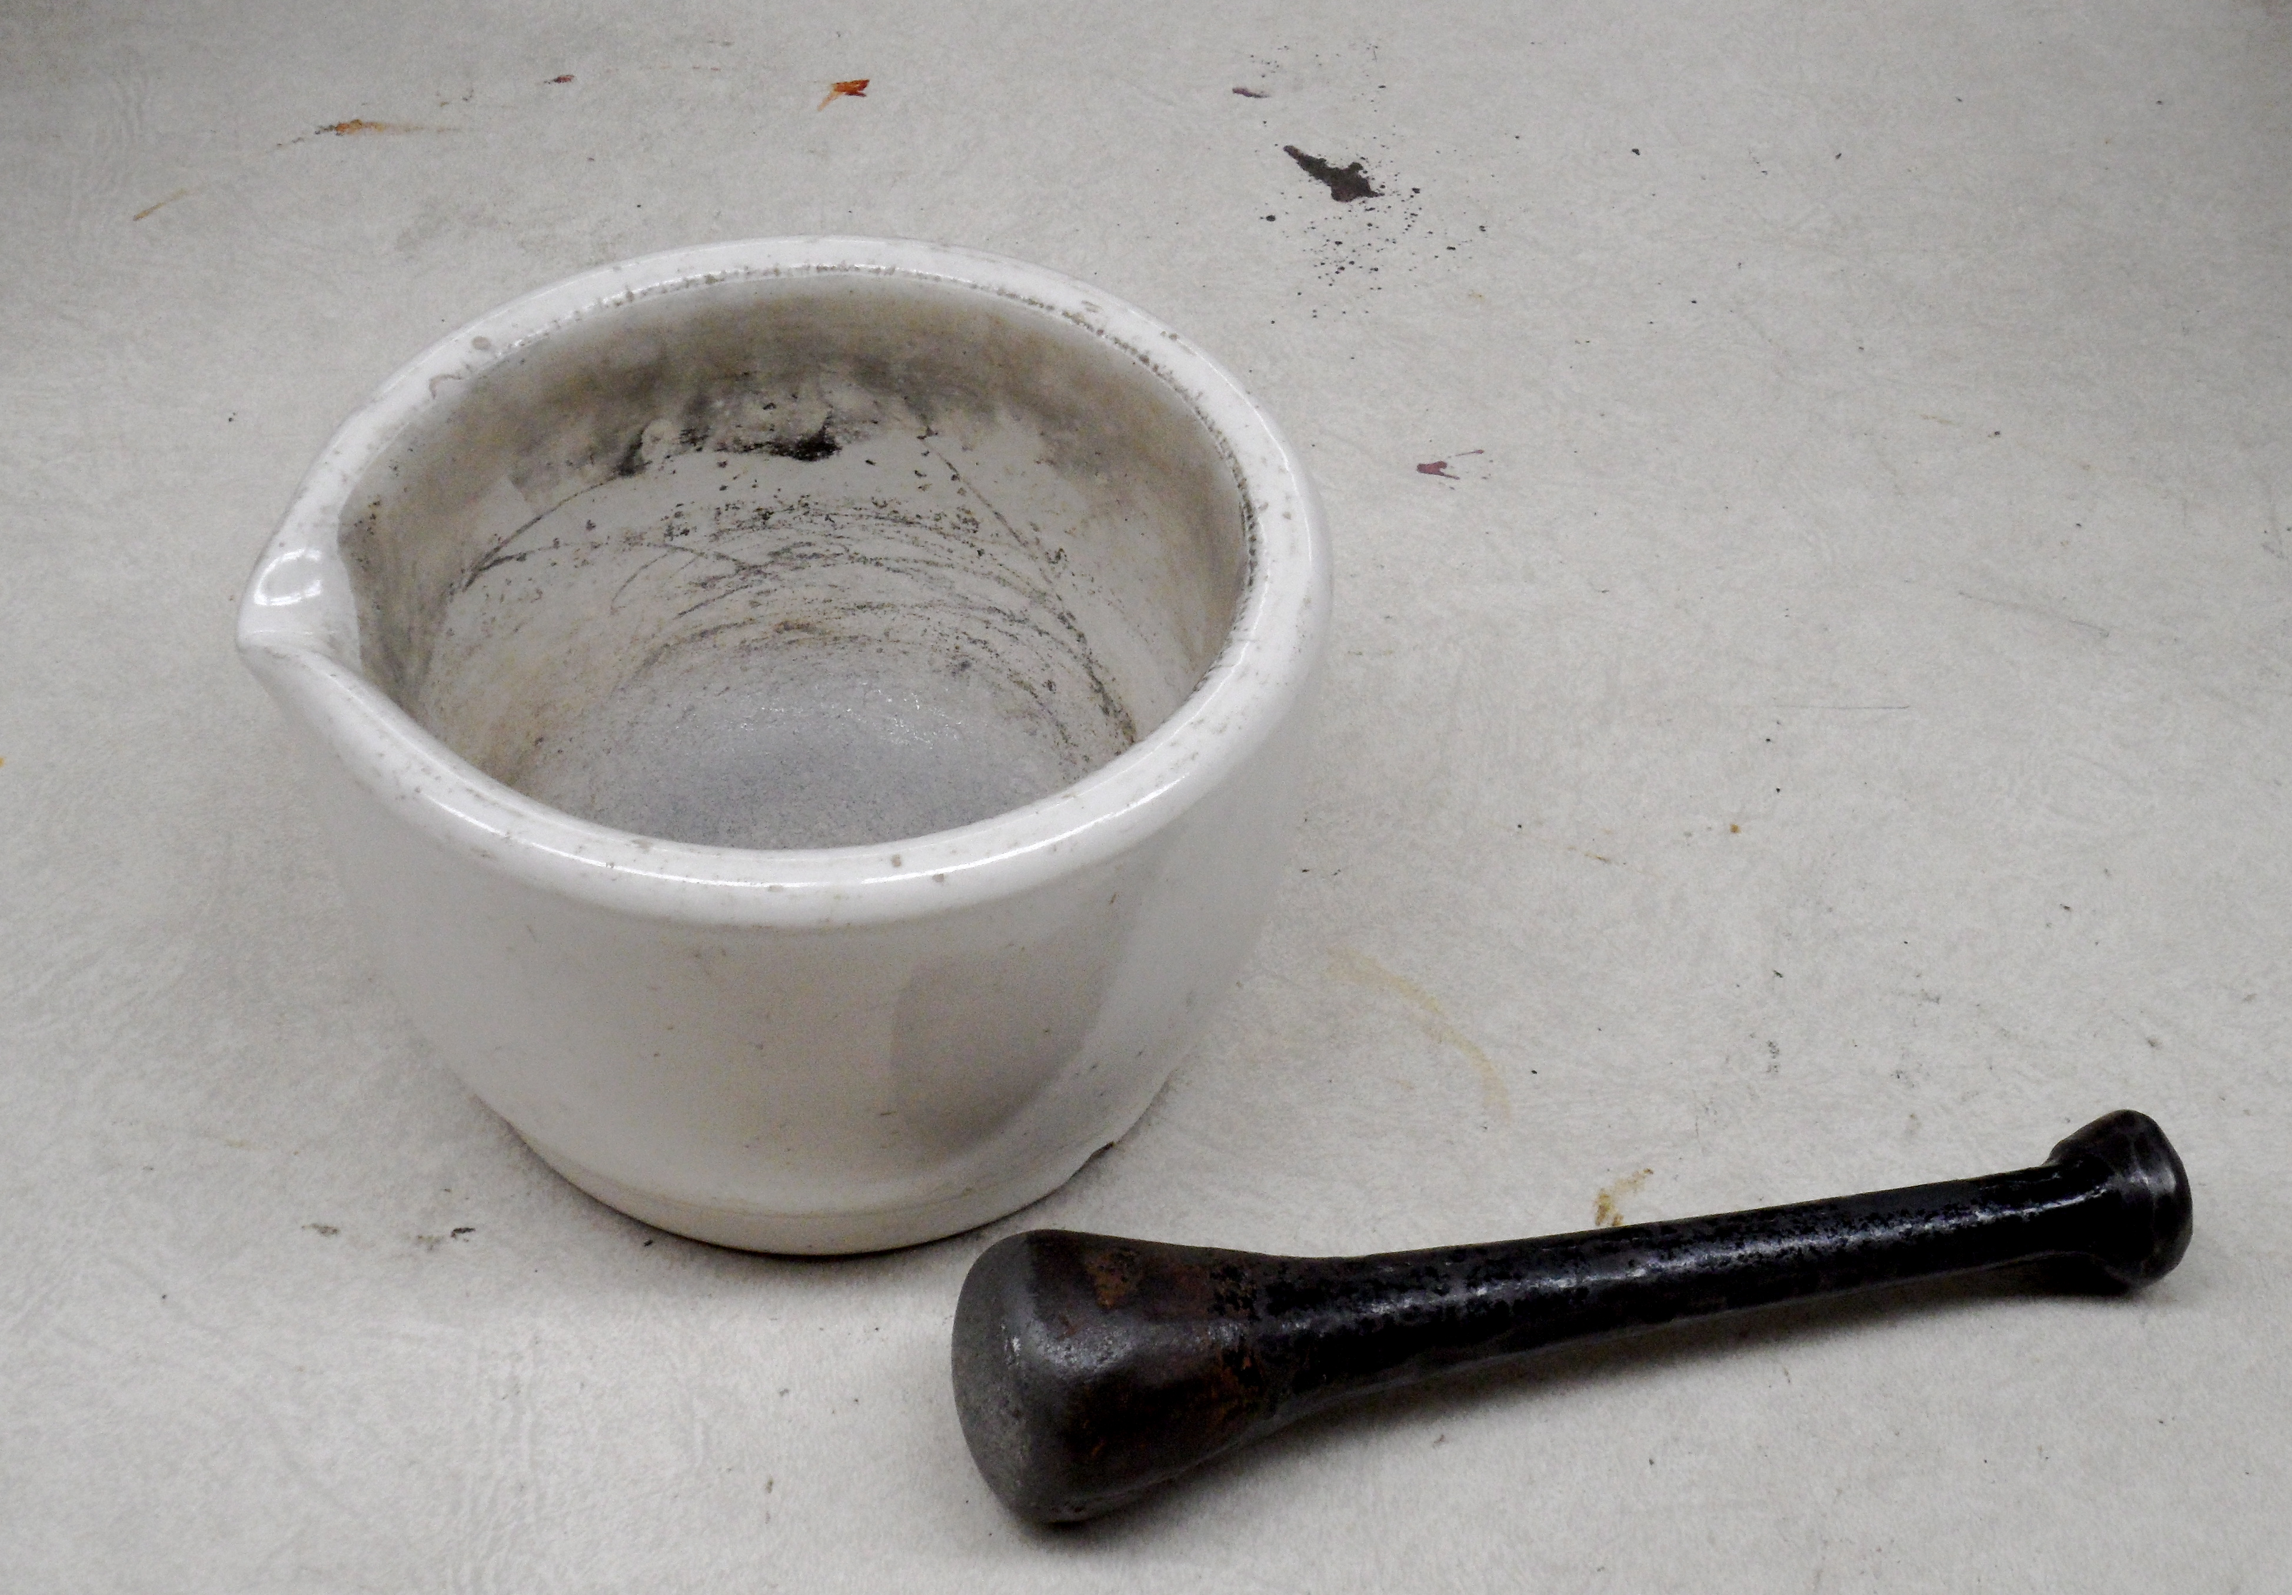
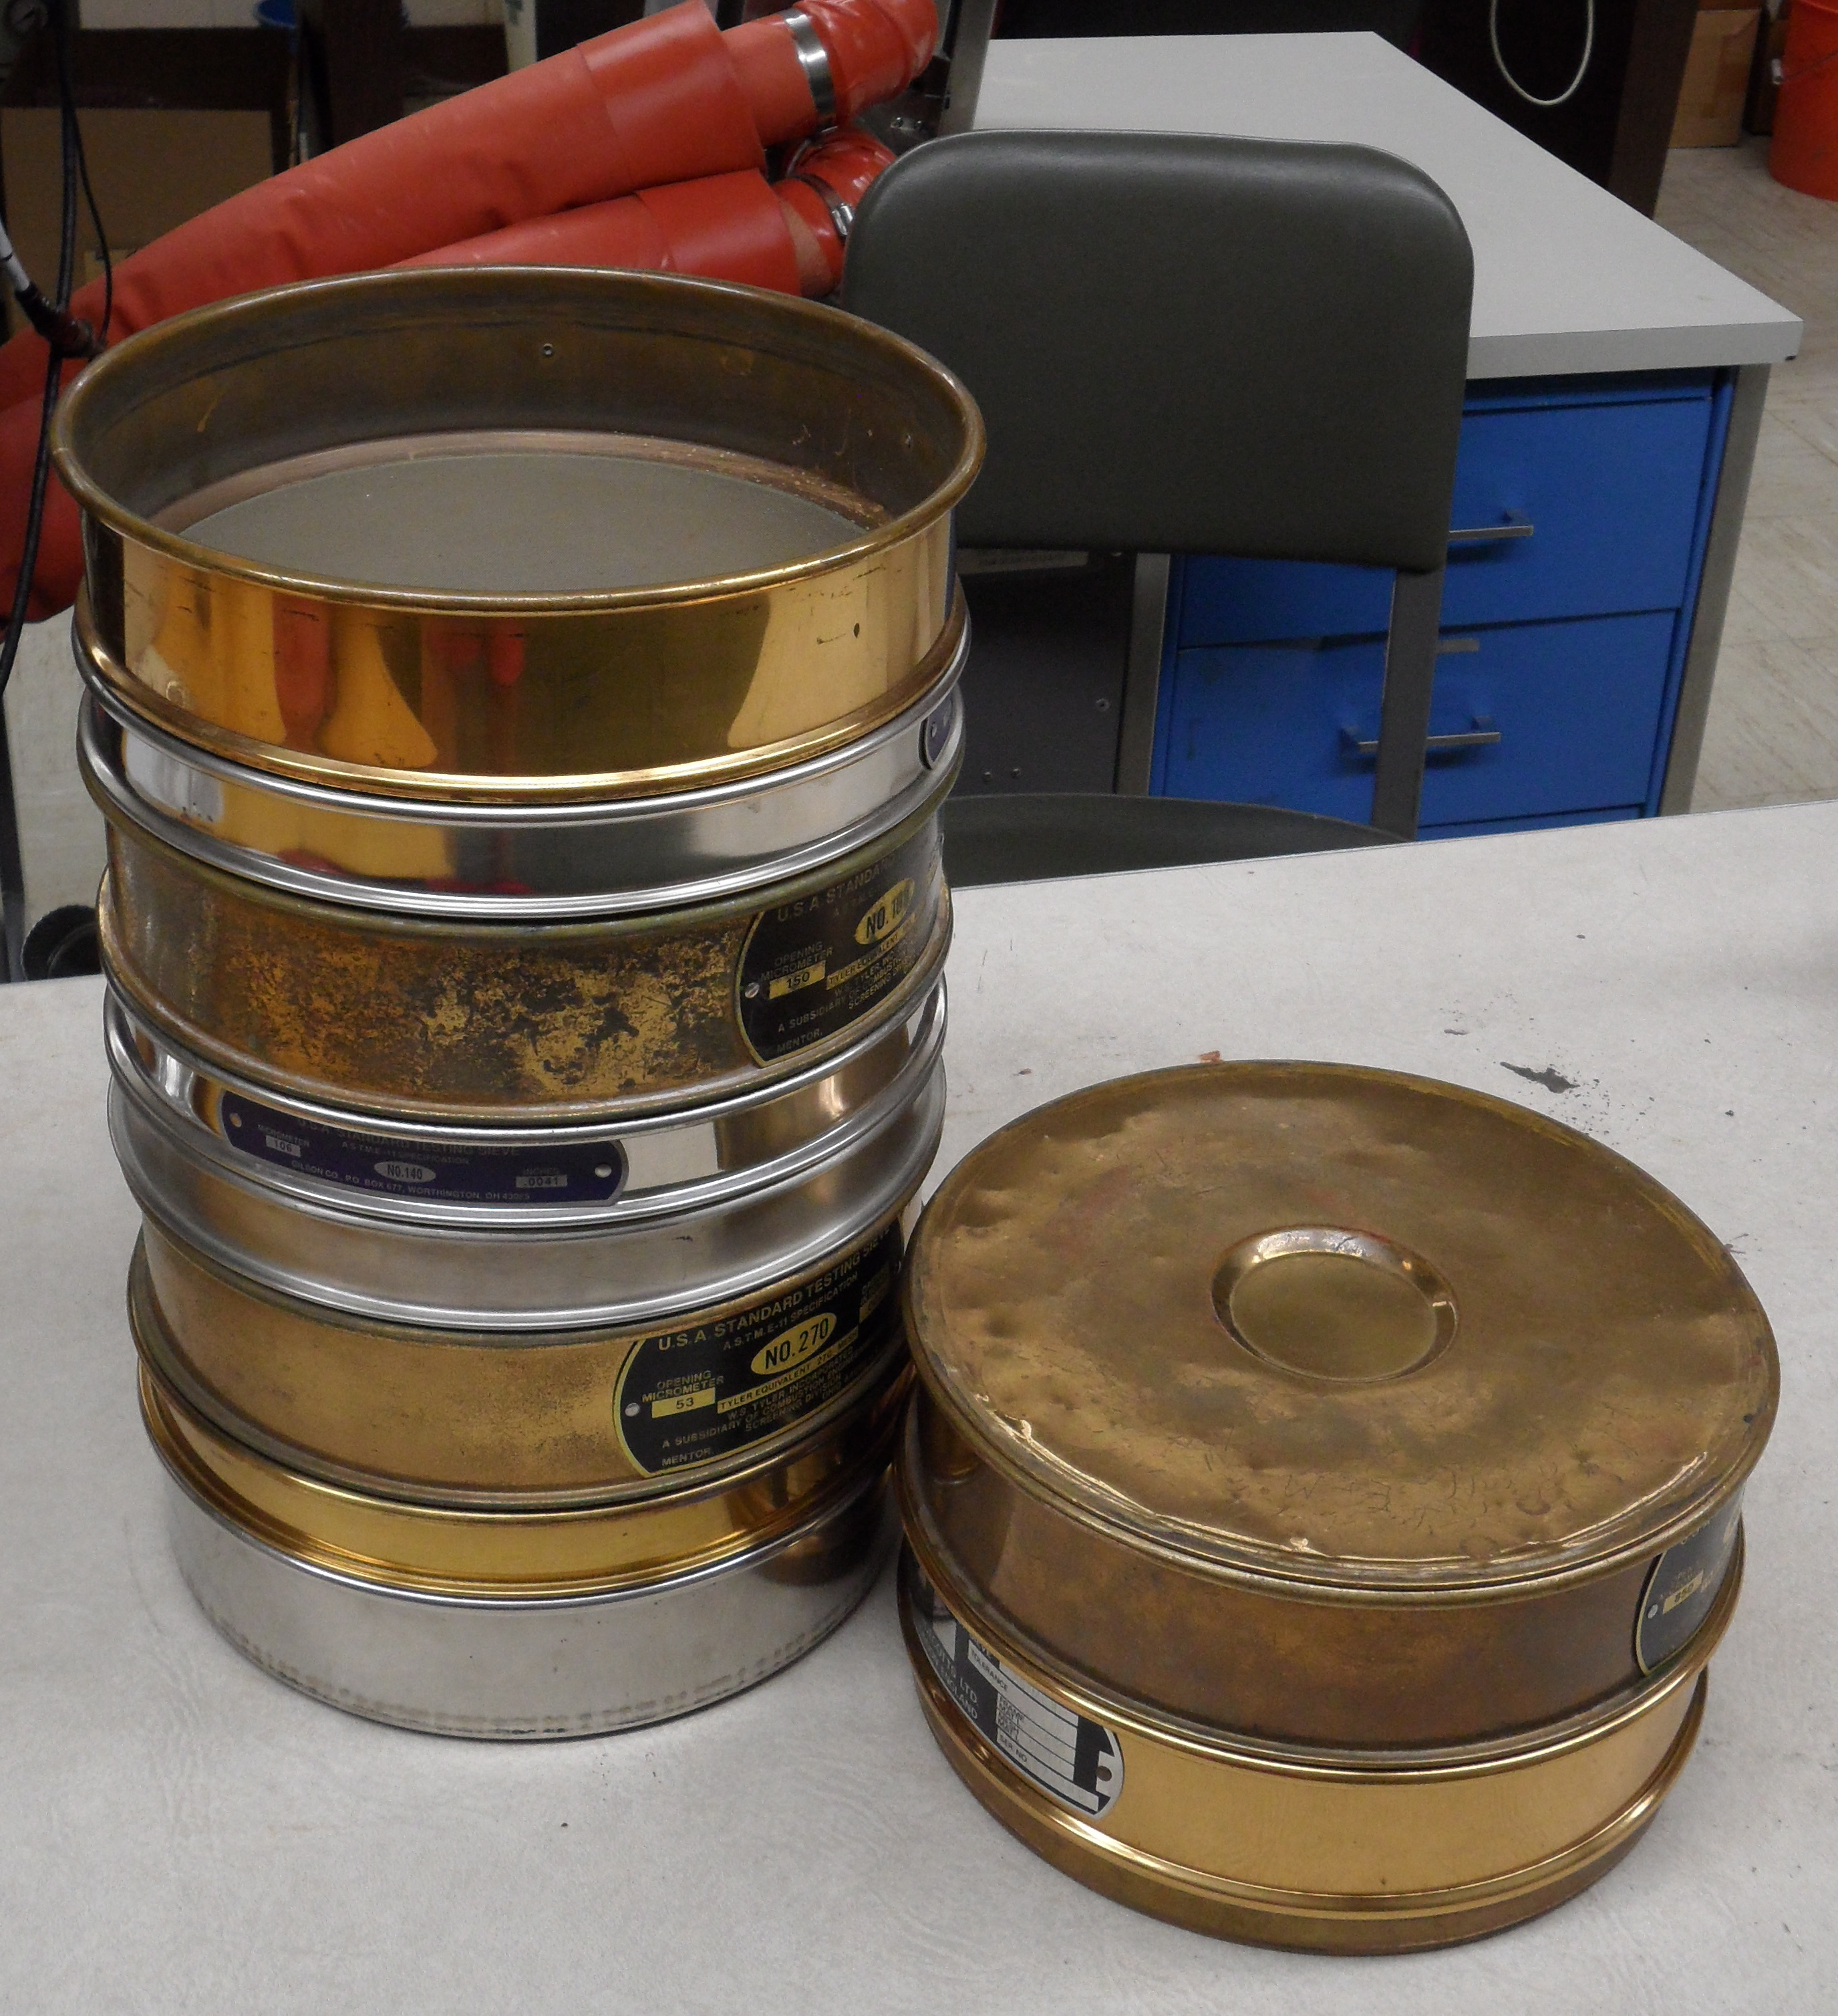
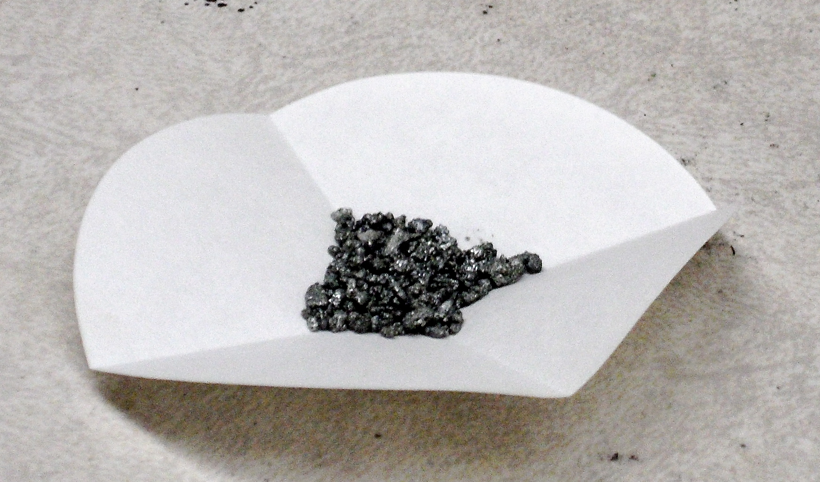
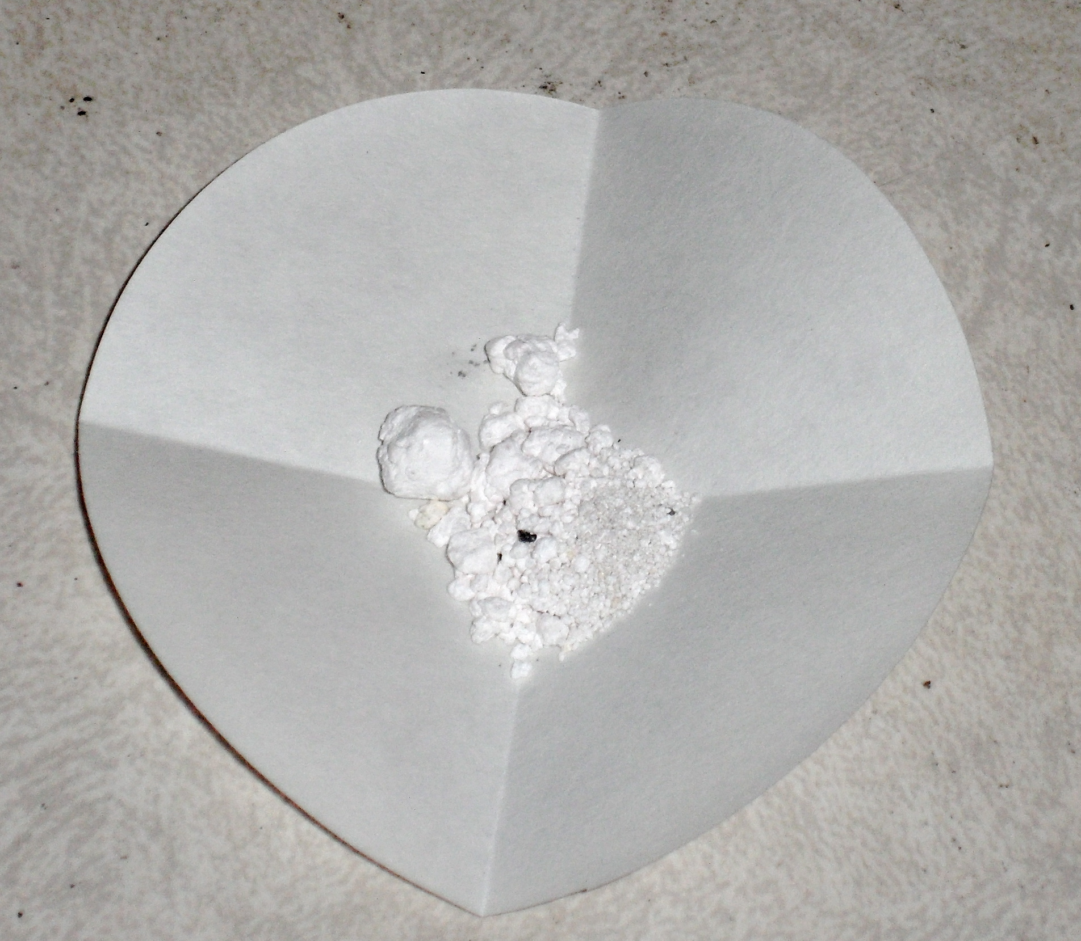
Mechanochemistry: from Faraday to Today
Ilona Phipps-Morgan (Harvey Mudd College & Scripps College)
Dr. William Cross (South Dakota School of Mines & Technology)
Research made possible by NSF REU Grant # DMR-0852057
Results
Figure 14: Result of grinding zinc with silver chloride for five minutes. The texture is moist and clumpy.
Figure 1: Michael Faraday, one of the first scientists to directly reference mechanochemistry in a paper (picture from http://www.gap-system.org/~historyPict Display/Faraday.html)
Conclusions
Background
Figure 7: Particle size distribution of unground 30-mesh zinc
Figure 9: XRD results of 30-mesh zinc
Figure 10: XRD results of silver chloride
Size modulus k of unground 30-mesh zinc (Figure 7) is 568.33 µm, which closely approximates expected value of 589 µm for US mesh 30.
Grinding reduces k to 368.81 µm and distribution modulus α decreases from 2.92 to 2.59, i.e. the width of distribution increases (Figure 8).
According to XRD, the original samples of 30-mesh zinc and silver chloride were pure (Figures 9 & 10).
After grinding, mixture visibly changes — compare original samples of zinc and silver chloride (Figures 5 & 6) to ground mixture (Figure 14).
XRD shows that freshly ground zinc/silver chloride mixture contains metallic silver, zinc, and zinc chloride hydroxide (Figure 11).
Zinc chloride readily absorbs moisture from the atmosphere to form zinc chloride hydroxide, increasing the mass of the ground zinc/silver chloride samples over time (Figure 13).
One-day-old ground zinc/silver chloride mixture contains more zinc chloride hydroxide than freshly ground mixture (compare Figures 11 and 12). XRD of the older mixture also shows silver chlorate; however, although silver chlorate was chosen as the best fit for those peaks unaccounted for by the other components, it is not perfect.
Mechanochemical processes were invented thousands of years ago, when humans learned to create fire: the mechanical action of, for example, rubbing sticks together to cause a chemical reaction involving fire is an early instance of mechanochemistry. However, Michael Faraday (Figure 1) was one of the first scientists to directly reference a mechanochemical process [1]. In 1820, Faraday published a paper on decomposing silver chloride through grinding with zinc, tin, copper, or iron [1]. Since then, mechanochemistry has become more widespread, and currently engineers and chemists are exploring the use of environmentally friendly mechanochemical processes in waste management [2]. Given the enormous amounts of waste currently produced, understanding mechanochemistry may be integral to devising safe and effective waste management strategies.
Figure 8: Particle size distribution of ground 30-mesh zinc
Figure 11: XRD results of ground 30-mesh zinc/silver chloride mixture immediately after grinding
Figure 12: XRD results of ground 30-mesh zinc/silver chloride mixture one day after grinding
Figure 13: Mass increase of three separate samples of ground 10-mesh zinc/silver chloride mixture. The masses have been normalized to the initial masses of each sample. Note that the third sample (Day 2, Test 1) was taken on a different day than the first two, which were taken on the same day. Because the humidities of the two days were different, it is unsurprising that the third series’ slope is very slightly different from the other two, which are nearly identical.
Objectives
Learn about past and future uses of mechanochemistry.
Review and explore historical experiments by Michael Faraday; determine the effect of zinc’s (Figure 5) particle size on its mechanochemical reaction with silver chloride (Figure 6).
Procedures
Sampling: use riffle splitter (Figure 2) to make representative samples of zinc and silver chloride.
Grinding: grind together zinc and silver chloride using a mortar and pestle (Figure 3), as Faraday would have done. Note that although both 10-mesh and 30-mesh zinc were used, for brevity only 30-mesh zinc is discussed in the results.
Particle size characterization: use sieve nest (Figure 4) and/or Laser Particle Size Analyzer to characterize the particle sizes of the original zinc samples and the ground zinc/silver chloride samples.
X-ray diffraction: run XRD on original zinc and silver chloride samples and on the ground zinc/silver chloride samples to determine the components of the samples.
References
Figure 2: Riffle splitter
Figure 3: Mortar and pestle used for grinding
Figure 4: Sieve nest
1. Takacs, L. (2007). The mechanochemical reduction of AgCl with metals: revisiting an experiment of M. Faraday. Journal of Thermal Analysis and Calorimetry, 90(1), 81-84.
2. Guo, X., Xiang, D., Duan, G., & Mou, P. (2010). A review of mechanochemistry applications in waste management. Waste Management, 30, 4-10.
Acknowledgments
I would like to thank my advisor, Dr. William Cross, for his help, guidance, and inspiration and Dr. Alfred Boysen for providing motivation and critique. Thanks as well to Russ Lingenfelter for his assistance with the XRD, to Dr. Edward Duke for his assistance with the SEM, to Kelsey Fitzgerald and Jay Marshall for helping me to find equipment, and, last but not least, to REU site director Dr. Michael West for coordinating the program and for his thoughtfulness and help throughout.
Figure 5: 10-mesh metallic zinc
Figure 6: Silver chloride

